Slide 1

Machine Learning Model Deployment
Benedictus Aryo

Slide 2
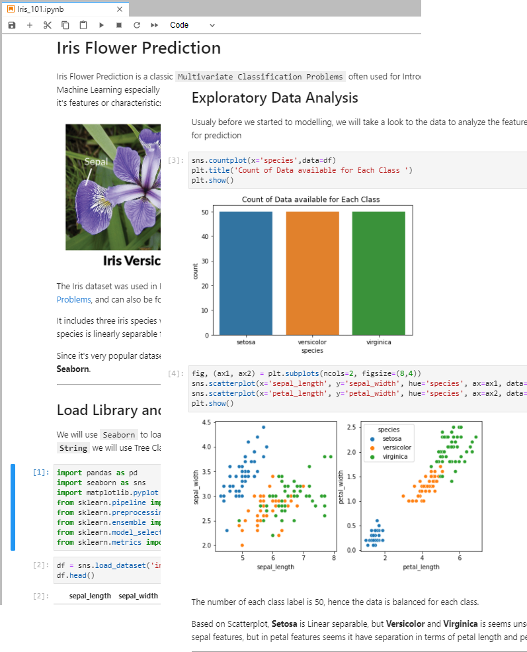
Let’s imagine this scenario
After finishing your Analysis on a dataset and finally you created the best performance machine learning model in Jupyter Notebook.
How can people make use of your result ?

Slide 3
Can we just send them the Jupyter notebook files and let them run it ?
They should have Anaconda or Jupyter Notebook / Lab installed right ?

Slide 4
Depends on..
Are the users know how to set up Python Environment ?
Are the users need to know python programming ?
Yes
Are the users Data Scientist or Machine Learning Engineer who want to know your process of thinking?
Yes
Then Just send the Jupyter Notebook Files
Yes
No
No
No
No
Then make something else

